Slide 1
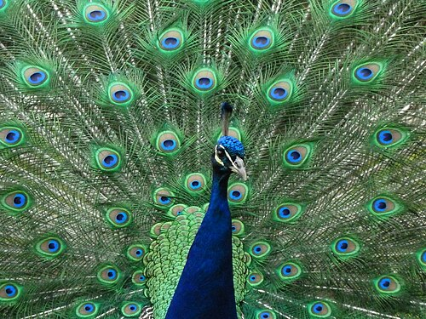
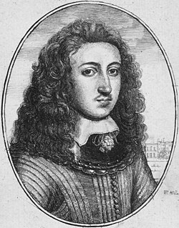
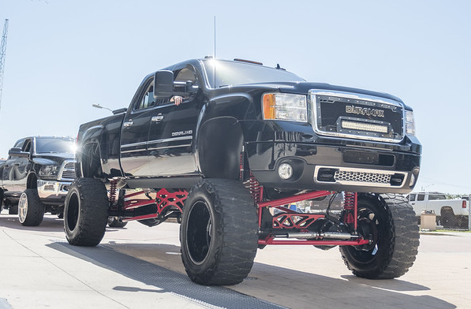
Sexual selection: The most attractive individuals will have more offspring, more genes in future generations.
“I’m so wealthy that I can afford to waste valuable resources on useless stuff.”
Big Hair!
Big tail!
Big truck!
Notes:
The large tail feather displays of male peacocks might be the result of female sexual selection for dramatic displays.
The lifted truck example was inspired by Levitin (2006, Brain on Music, p. 253). Levitin uses status cars as an example of human sexual selection. This is a dramatic display of resources and wealth intended to signal fitness to the opposite sex. “I’m wealthy and can afford to waste resources on useless stuff.”
Wikipedia: Another possibility is that long head hair is a result of Fisherian runaway sexual selection, where long lustrous hair is a visible marker for a healthy individual.
https://en.wikipedia.org/wiki/Long_hair
https://en.wikipedia.org/wiki/Fisherian_runaway
Images:
https://fr.wikipedia.org/wiki/Th%C3%A9orie_%C3%A9volutive_des_jeux#/media/Fichier:Peacock_at_Warwick_Castle.jpg
https://www.flickr.com/photos/candelabrumdanse/43221797524
A man with shoulder length hair, 1659 https://en.wikipedia.org/wiki/Long_hair#/media/File:Wenceslas_Hollar_-_Young_man_with_long_hair_(State_1).jpg
https://www.flickr.com/photos/candelabrumdanse/43221797524

