Slide 1
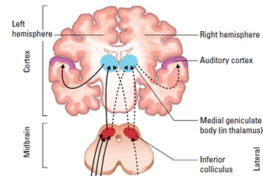
Auditory information processing in the brain.
Notes:
We have focused so far on the neurobiology of the ear. This is just the starting point though. The brain performs a process called perception, in which auditory information is understood and made useful. The interpretation of sensory information is a critical step in the process.
This presentation will step through stages of processing as auditory information makes its way to the cerebral cortex. We will finish with language processing as a special form of auditory processing.

Slide 2
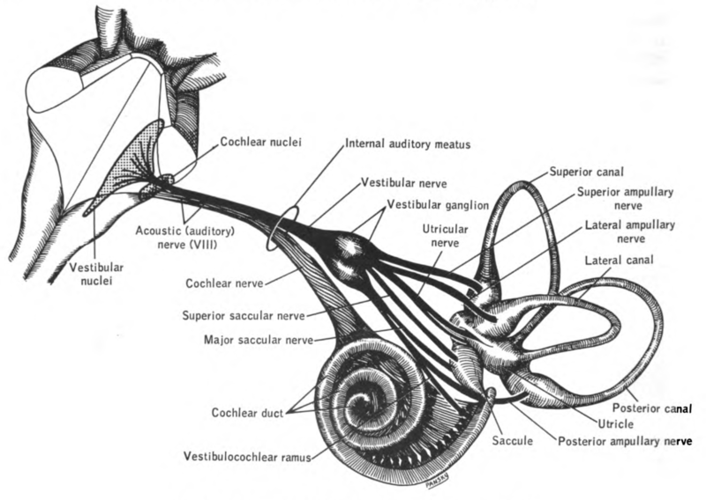
The cochlear nerve and the vestibular nerve combine to form the auditory nerve (AKA acoustic nerve, cranial nerve VIII, “8”).
Notes:
Sensory information from the vestibular system and the cochlea combines to form the auditory nerve. This nerve is a bundle of axons from ganglion cells inside these hearing structures. The information about balance and hearing will travel along this nerve in the form of action potentials. The nerve enters the brainstem on the ventral (bottom) side, which is shown here bottom-side up.
https://commons.wikimedia.org/wiki/File:Lawrence_1960_17.22.png

Slide 3
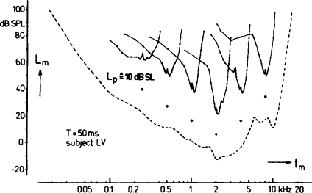
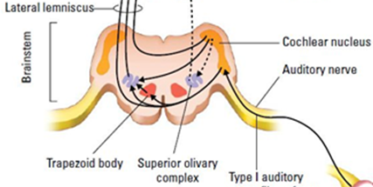
The cochlear nucleus in the brain stem has tuning curves. Each neuron responds best to a particular frequency.
Notes:
The brainstem contains clusters of cells called nuclei. These clusters are similar to the clusters that we described earlier in the hypothalamus, but the function is related to the auditory system rather than hunger or thirst.
Each neuron seems tuned to a particular sound frequency. This is called a tuning curve, in which neurobiologists can systematically map which frequencies a neuron will respond to: high, medium, or low. The tuning curve shows each neuron has a frequency that it selectively responds to. The frequencies outside of this tuned range will have no effect.
The brainstem is also the beginning of perceptual processing. The nuclei in this region can compare the timing and intensity of the sounds coming in from each ear. This information is used to judge where in space a sound is coming from. “The cochlear nuclear complex is the first integrative, or processing, stage in the auditory system. “
https://en.wikipedia.org/wiki/Cochlear_nucleus
Figure 2. Psychophysical tuning curves determined in simultaneous masking, using sinusoidal signals at 10 dB SL. For each curve, the solid diamond below it indicates the frequency and the level of the signal. The masker was a sinusoid that had a fixed starting phase relationship to the brief, 50 ms, signal. The masker level, L_{m}, required for threshold is plotted as a function of masker frequency, f_{m}, on a logarithmic scale. The dashed line shows the absolute threshold for the signal.
(From Vogten, 1974, by permission of the author.)
https://www.sciencedirect.com/topics/biochemistry-genetics-and-molecular-biology/tuning-curve

Slide 4
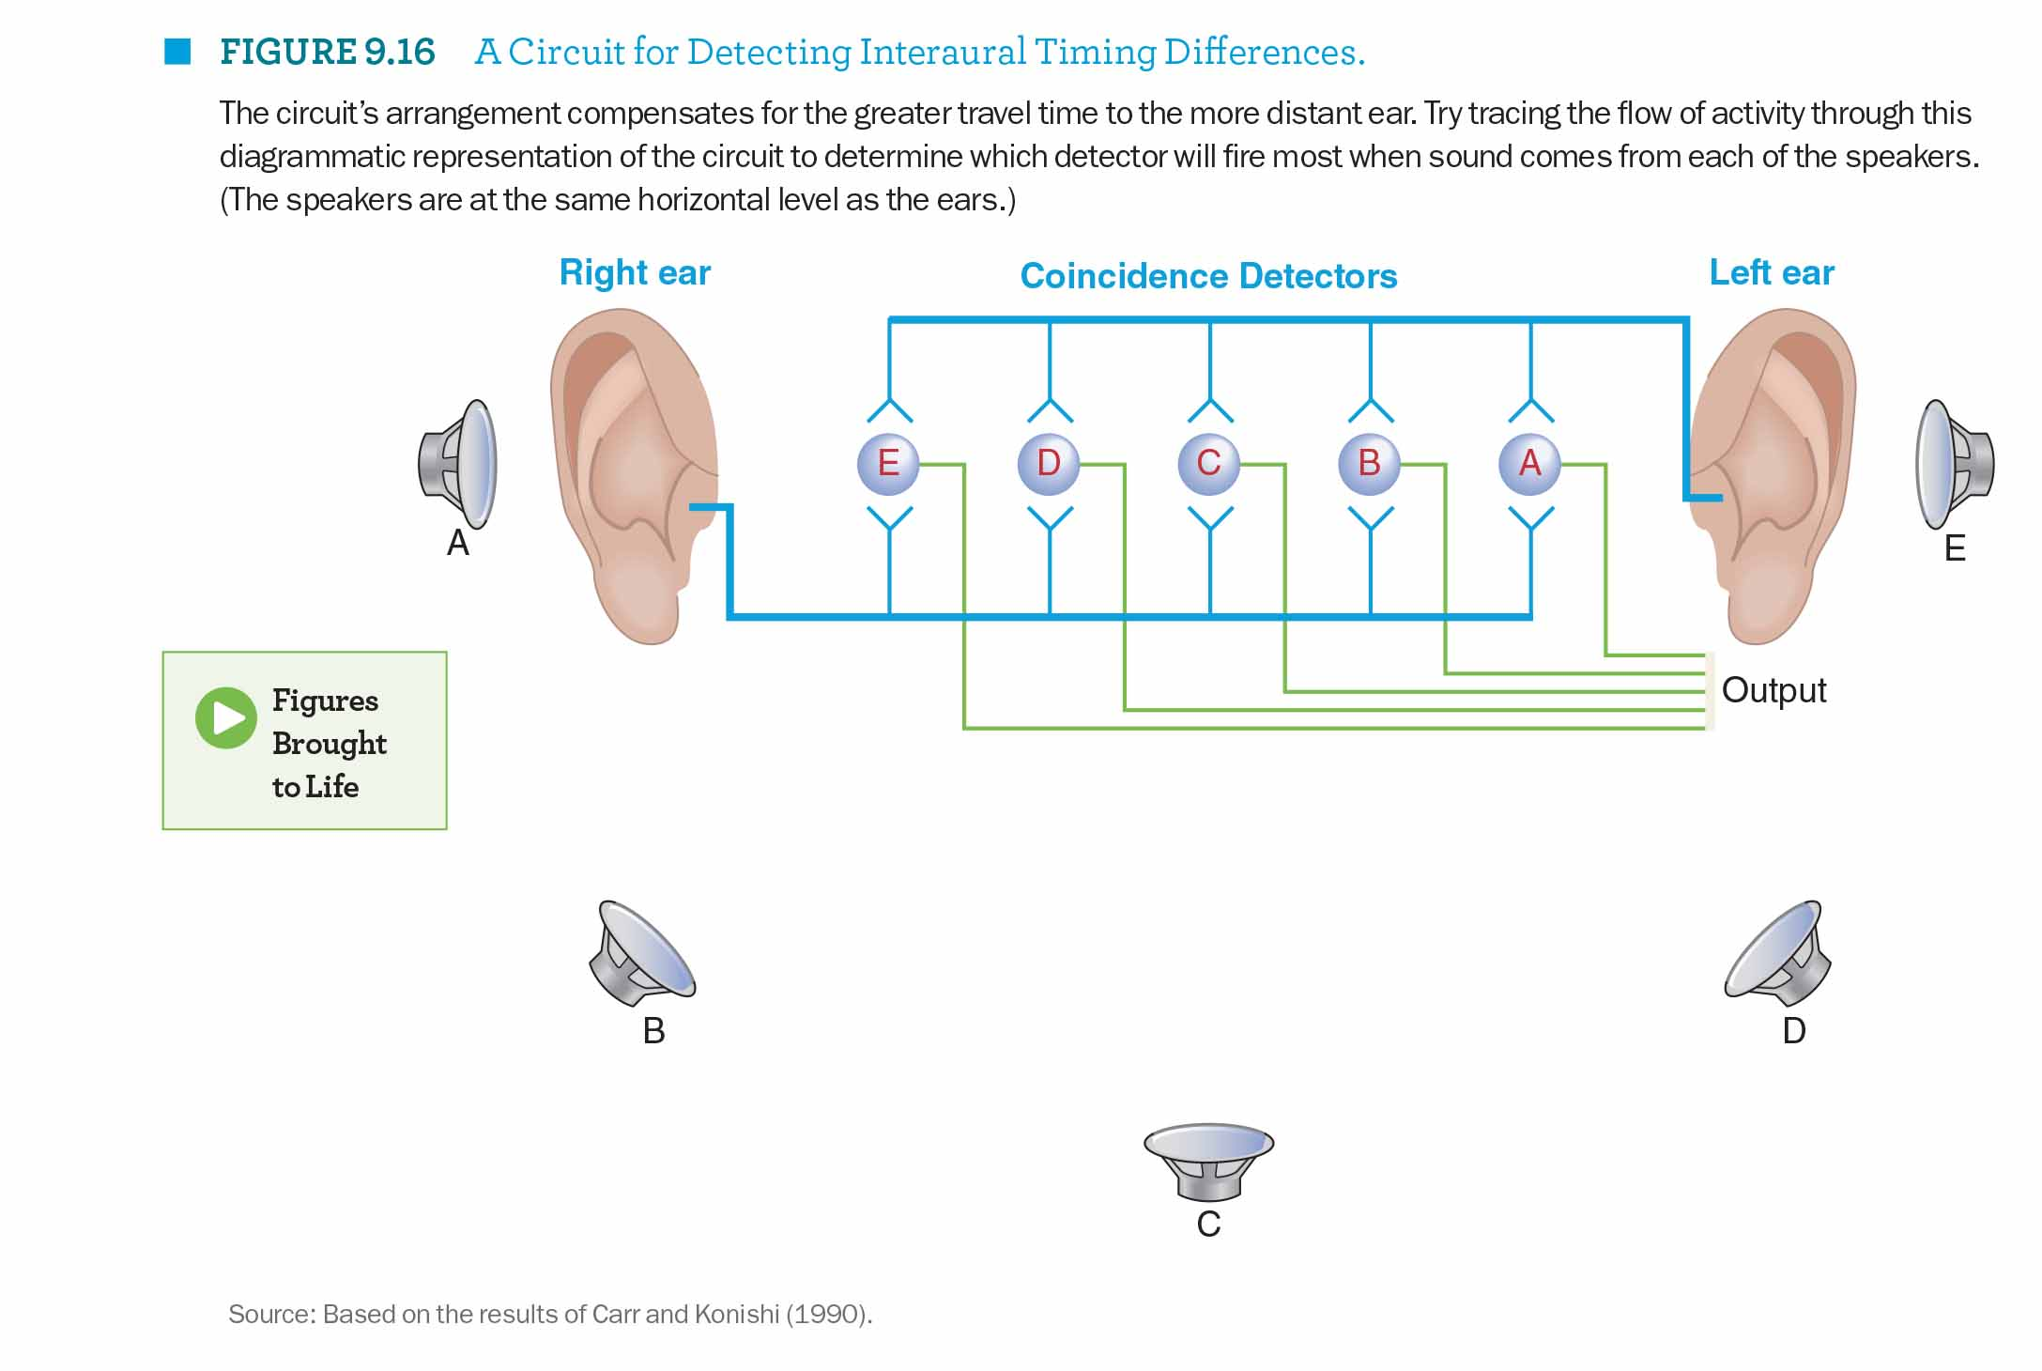
Sound is direction is determined by the medial superior olive, which compares both ears for small time differences.
Notes:
This diagram shows how sound is localized in brain stem nuclei like the medial superior olive. Image that this diagram represents a person (see the ears) who is facing towards you. The person is surrounded by sounds that can come from different locations (see the speakers). The circles E through A in the middle represent neurons in the medial superior olive.
Now let’s imagine a sound that comes in from location A. This sound will hit the right ear first. The information from the right ear will hit neuron E first and neuron A last. The same sound will enter the left ear a few milliseconds later. The sound information from the left ear will hit neuron A first and neuron E last, which is the opposite pattern from the right ear. Altogether, the timings and intensities of sound-related information coming in from each ear will be slightly different. These small timing differences can be used to determine where a sound is coming from.

Slide 5
The inferior colliculus coordinates sound with vision for eye movement, sensory integration.
Inferior colliculus
Notes:
The auditory information from the brainstem goes upwards in the brain through several steps of processing. The inferior colliculus is another important region for determining where sounds are coming from. It may coordinate some of this information with eye movements. For example, if we hear a loud sound we might turn our eyes in the direction of the loud sound to see where it is coming from. The eye movement part is a reflex that happens in this part of the brain.
The next stage is the medial geniculate nucleus in the thalamus of the brain. The thalamus is a gateway to the cerebral cortex. All sensory information except possibly olfaction goes to the thalamus first before the information is relayed on to the next step in cerebral cortex.
Finally, sound information arrives at the auditory cortex. This is located on the dorsal (top) part of the temporal lobe. The above picture shows a cross (coronal) section of the brain from ear to ear. The auditory cortex is the purple part on top of the lobe.

Slide 6
The thalamus a relay station before cerebral cortex. Medial geniculate nucleus: Thalamus region for hearing.
Thalamus
Notes:
The auditory information from the brainstem goes upwards in the brain through several steps of processing. The inferior colliculus is another important region for determining where sounds are coming from. It may coordinate some of this information with eye movements. For example, if we hear a loud sound we might turn our eyes in the direction of the loud sound to see where it is coming from. The eye movement part is a reflex that happens in this part of the brain.
The next stage is the medial geniculate nucleus in the thalamus of the brain. The thalamus is a gateway to the cerebral cortex. All sensory information except possibly olfaction goes to the thalamus first before the information is relayed on to the next step in cerebral cortex.
Finally, sound information arrives at the auditory cortex. This is located on the dorsal (top) part of the temporal lobe. The above picture shows a cross (coronal) section of the brain from ear to ear. The auditory cortex is the purple part on top of the lobe.

Slide 7
In cerebral cortex, auditory information is processed in the dorsal (top) part of the temporal lobe.
Auditory Cortex
Notes:
Finally, sound information arrives at the auditory cortex. This is located on the dorsal (top) part of the temporal lobe. The above picture shows a cross (coronal) section of the brain from ear to ear. The auditory cortex is the purple part on top of the lobe.

Slide 8
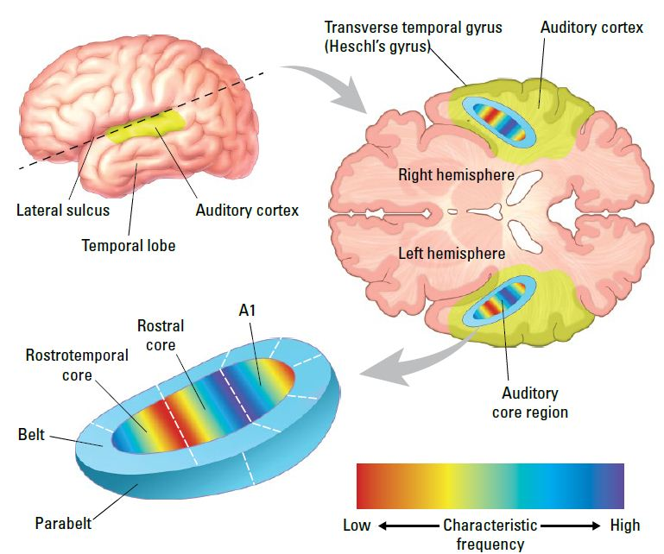
Tonotopic organization is an orderly map of sound frequencies in auditory cortex.
Notes:
The last presentation showed how the cochlea had a layout organized by frequencies. This organization, which is called tonotopic (tono – tones; topic – map), has the high frequencies processed at the base (near the stapes) and the low frequencies processed at the end (the apex). The auditory cortex also has this similar organization of frequencies. The representation of the various frequencies is preserved through the many steps of processing. It is laid out in an orderly fashion in cerebral cortex.
The above illustration shows where auditory cortex is located (see top left). Slicing through this at the dotted line produces the horizontal cross-section shown on the right. The different sound frequencies are color coded low to high. A1 is primary auditory cortex, the first site of processing. The colors repeat themselves in neighboring regions of cortex that are related to auditory processing.

Slide 9
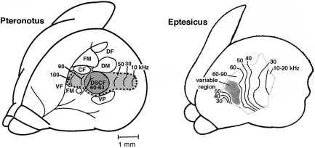
Bats have a large auditory cortex for echolocation.
Notes:
These maps of sound frequencies in auditory cortex are created by recording from cerebral cortex neurons, then playing sounds of different frequencies. They develop tuning curve maps to see which frequencies a neuron will respond to. If this is repeated many times over a large area of the brain a map of sound frequencies that produce the maximum response can be made.
The above example shows what these auditory cortex maps look like in two species of bats. This is special because bats use sound to navigate and catch insects at night. Their maps contain neurons sensitive to sounds that are well above what humans can hear, like sounds of 60,000 to 100,000 hertz. The above results are expressed in kilohertz, so 60,000 hertz is the same as 60 kilohertz.
Another striking part of these maps of bat auditory cortex is the large size of these representations. Their ability to navigate by sound and echolocation is very important, so a large part of the bat cerebral cortex is dedicated to this function.

Slide 10
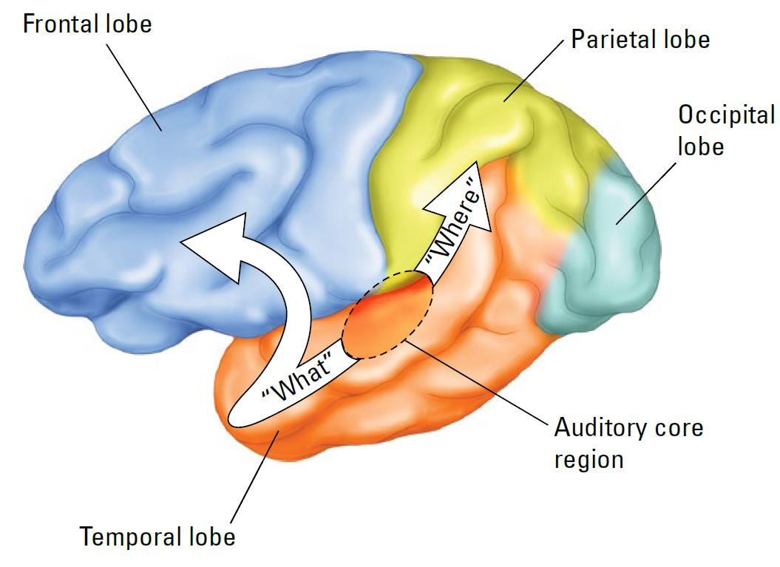
Auditory cortex connections contribute to the “what” (identification) and “where/how” (action) pathways.
Object location and use
Object identification
Notes:
The auditory cortex is only the starting point of what auditory information is doing in the brain. There are connections between areas in the cerebral cortex called corticocortical connections. This is a fancy way of saying connections going from one area of cerebral cortex to another area of cerebral cortex.
Some of this information goes to ventral and anterior areas of the temporal lobe that are important for identifying objects. This has been called the “what” stream or the ventral stream of processing. For example, let’s say you are exposed to a car sound. Connections from primary auditory cortex to this area will help you to understand that you are hearing a car.
The “where” stream (also called the dorsal stream) is important for knowing where objects are located in space. This is like a mental map of the world. For the car example, this region would give us a conscious appreciation if the sound is ahead, to the side, or behind us. The where stream may be important for preparing actions.

Slide 11
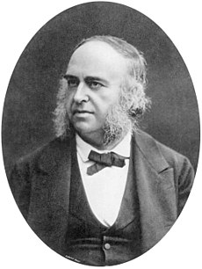
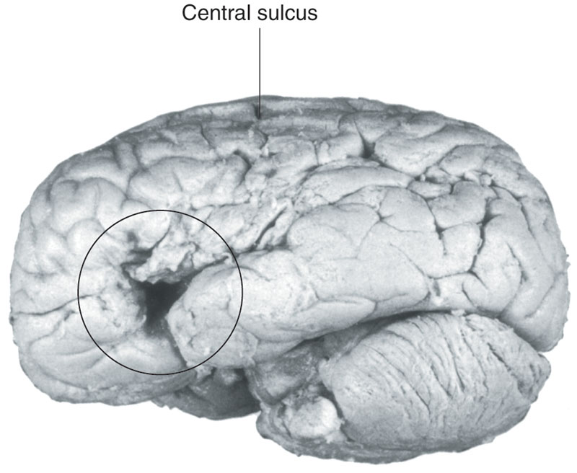
Paul Broca (1861) described a language center for speech production in the left frontal lobe. Breakthrough!
The brain of Louis Victor Leborgne
Notes:
Other corticocortical connections are important for language processing. Paul Broca was a French doctor who first reported a patient with impaired language production caused by damage to the left frontal lobe. The area of damage is circled. This area is sometimes called Broca’s area. The primary function of this area is to string words together into sentences. This is called expressive aphasia, an inability to fluently make language such as sentences. People with this condition may struggle to find the right word to say, which is a symptom called anomia.
https://blogs.scientificamerican.com/literally-psyched/the-man-who-couldnt-speakand-how-he-revolutionized-psychology/

Slide 12
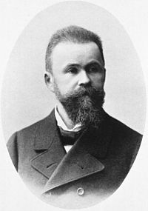
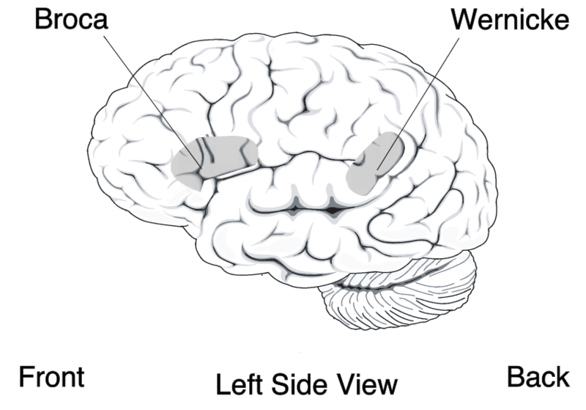
Carl Wernicke (late 1800s) – speech comprehension in the left side slightly posterior of the auditory cortex.
Notes:
Carl Wernicke was a German physician who described another left hemisphere area for language in the late 1800s. The people with damage in this area can produce sentences but cannot understand sentences very well. This language deficit pattern is now called receptive aphasia. The problem is in receiving language.
By J.F. Lehmann, Muenchen - IHM, Public Domain, https://commons.wikimedia.org/w/index.php?curid=9679254

Slide 13
Wernicke’s area is next to auditory cortex. Connections between these areas are important for speech perception.
Primary auditory cortex
Notes:
Now we will tie this language information in with auditory cortex. Note that primary auditory cortex is located in between Broca’s and Wernicke’s areas of the brain. There are cortical connections from primary auditory cortex to Wernicke’s area that are important for understanding what language means. Wernicke’s area also has connections to Broca’s area for speech production. The connections between these brain areas are very important for the components of speech, both understanding speech (Wernicke’s area) and producing speech (Broca’s area).
https://commons.wikimedia.org/wiki/File:BrocasAreaSmall.png

Slide 14
Strokes in the middle cerebral artery may damage all of these areas, resulting in severe impairment.
Primary auditory cortex
Middle cerebral artery
Notes:
There is a practical side to understanding this circuitry of language comprehension and production. A major artery in the brain, the middle cerebral artery, is located between the frontal lobe and the temporal lobe (see green line). This artery is a common site of obstructions in blood flow that result in strokes. The area circled in blue above gets the blood supply from this artery. Strokes in the middle cerebral artery can affect the entire region of the brain, resulting in hearing loss as well as deficits in language comprehension or production. Really severe cases result in global aphasia, where people can neither understand nor comprehend language. These are very sad situations because these people are greatly impaired in communicating with others.
https://commons.wikimedia.org/wiki/File:BrocasAreaSmall.png

Slide 15
Wernicke-Geschwind model of language processing:
#4
Motor
#2 Wernicke
#3 Broca
#1 Auditory
Notes:
Language processing involves multiple steps. The Wernicke-Geschwind model suggests the following stages. Note that these are happening in different regions of the cerebral cortex. Cortical neurons have axons that connect to other cortical areas (corticocortical connections) that do different forms of processing.
1. Auditory cortex: Hearing 2. Wernicke’s area: speech comprehension 3. Arcuate fasiculus (a connection pathway) 4. Broca’s area: speech production 5. Motor cortex for muscle movements
https://commons.wikimedia.org/wiki/File:BrocasAreaSmall.png

